Slide 1
Using Dataflow Diagrams
7
Systems Analysis and Design,
Kendall & Kendall
© 2008 Pearson Prentice Hall

Slide 2
Data Flow Diagrams
Graphically characterize data processes and flows in a business system
Depict:
  System inputs
  Processes
  outputs
Kendall & Kendall
7-<number>
Notes:
A series of layered data flow diagrams may be used to represent and analyze detailed procedures in the larger system.

Slide 3
Advantages of the Data Flow Approach
Freedom from committing to the technical implementation too early
Understanding of the interrelatedness of systems and subsystems
Communicating current system knowledge to users
Analysis of the proposed system
Kendall & Kendall
7-<number>

Slide 4
Basic Symbols
A double square for an external entity
An arrow for movement of data from one point to another
A rectangle with rounded corners for the occurrence of a transforming process
An open-ended rectangle for a data store
Kendall & Kendall
7-<number>

Slide 5
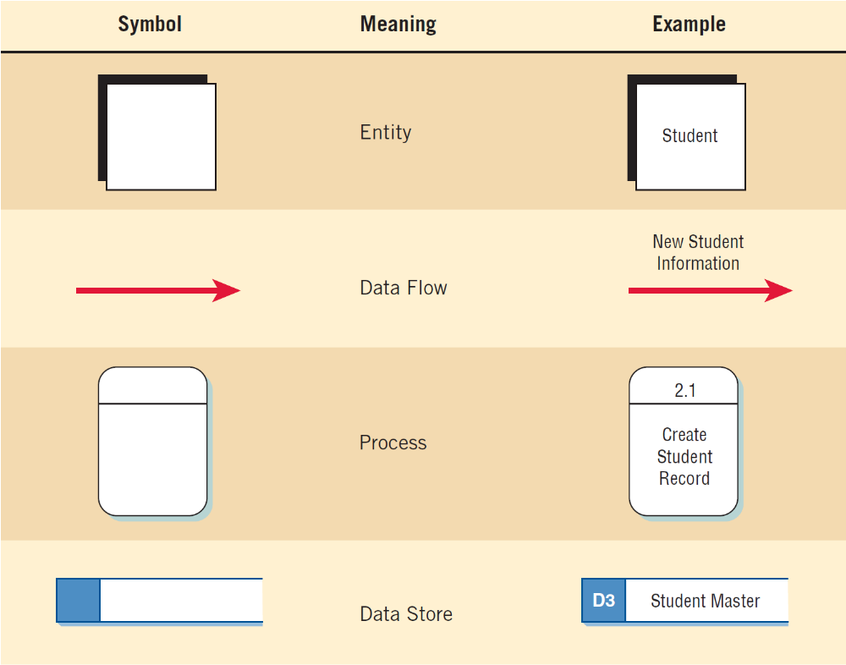
Figure 7.1 The four basic symbols used in data flow diagrams, their meanings, and examples
Kendall & Kendall
7-<number>
Notes:
An entire system and numerous subsystems can be depicted graphically with these four symbols in combination.

Slide 6
External Entities
Represent another department, a business, a person, or a machine
A source or destination of data, outside the boundaries of the system
Should be named with a noun
Kendall & Kendall
7-<number>
Notes:
An external entity (outside the boundaries of the system) sends data to (source) or receives data from (destination) the system.
Each entity is labeled with a name, generally a noun.
The same entity may be used more than once on a given data flow diagram.

Slide 7
Data Flow
Shows movement of data from one point to another
Described with a noun
Arrowhead indicates the flow direction
Represents data about a person, place, or thing
Kendall & Kendall
7-<number>
Notes:
Data flows occurring simultaneously can be depicted doing just that through the use of parallel arrows.

Slide 8
Process
Denotes a change in or transformation of data
Represents work being performed in the system
Naming convention
  Assign the name of the whole system when naming a high-level process
  To name a major subsystem attach the word “subsystem” to the name
  Use the form verb-adjective-noun for detailed processes e.g. “print sales report”, “prepare shipping invoices”
Kendall & Kendall
7-<number>
Notes:
The data flow leaving a process is always labeled differently then the data flow entering the process.
A process must also be given a unique identifying number indicating its level in the diagram.

Slide 9
Data Store
A depository for data that allows examination, addition, and retrieval of data
Named with a noun, describing the data
Data stores are usually given a unique reference number, such as D1, D2, D3
Represents a:
  Filing cabinet
  Database
  Computerized file
Kendall & Kendall
7-<number>
Notes:
Data stores represent a person, place, or thing which is why they are named with a noun.
Temporary data stores, such as scratch paper or a temporary computer file are not included on the data flow diagram.

Slide 10
Creating the Context Diagram
The highest level in a data flow diagram
Contains only one process, representing the entire system
The process is given the number 0
All external entities, as well as Major data flows are shown
Kendall & Kendall
7-<number>
Notes:
Basically the context diagram consists of
one process – depicting the entire system
external entities
data flows from the external entities to the process
The diagram does not contain any data stores.

Slide 11
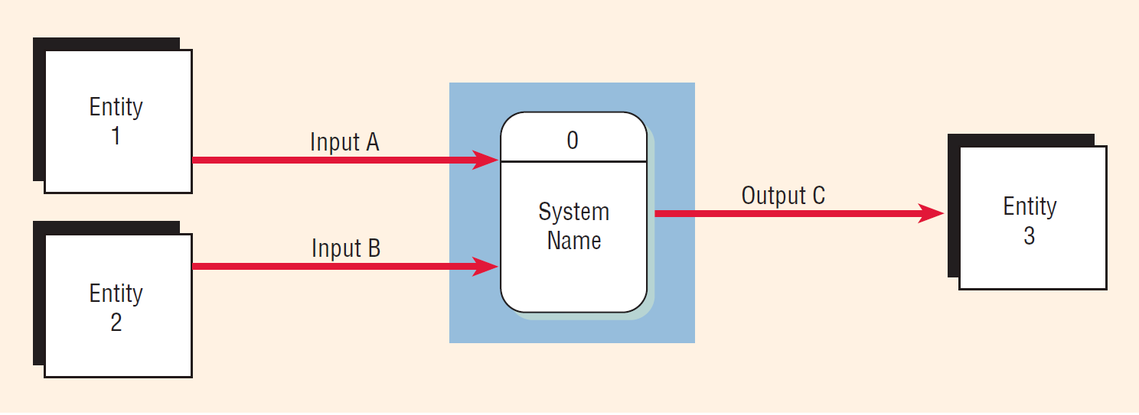
Figure 7.3 Context diagram
Kendall & Kendall
7-<number>

Slide 12
Drawing Diagram 0
The explosion of the context diagram
May include up to nine processes
Each process is numbered
Major data stores and all external entities are included
Kendall & Kendall
7-<number>
Notes:
Including more than nine processes will result in a cluttered diagram that is difficult to understand.
Each process is numbered with an integer, starting form the upper left-hand corner and working toward the lower right-hand corner.
Because a data flow diagram is two-dimensional, you can start at any point and work forward or backward through the diagram.

Slide 13
Drawing Diagram 0 (Continued)
Start with the data flow from an entity on the input side
Work backwards from an output data flow
Examine the data flow to or from a data store
Analyze a well-defined process
Take note of any fuzzy areas
Kendall & Kendall
7-<number>
Notes:
Because a data flow diagram is two-dimensional, you can start at any point and work forward or backward through the diagram.

Slide 14
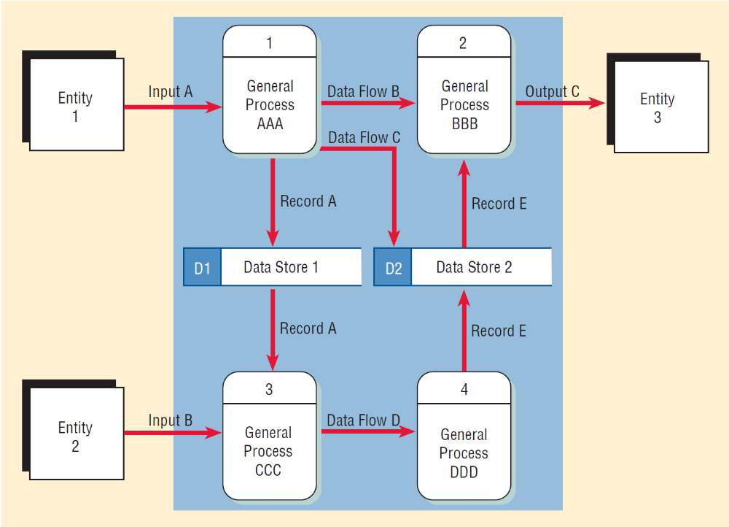
Figure 7.3 Note the greater detail in diagram 0
Kendall & Kendall
7-<number>

Slide 15
Data Flow Diagram Levels
Data flow diagrams are built in layers
The top level is the Context level
Each process may explode to a lower level
The lower level diagram number is the same as the parent process number
Processes that do not create a child diagram are called primitive
Kendall & Kendall
7-<number>

Slide 16
Creating Child Diagrams
Each process on diagram 0 may be exploded to create a child diagram
A child diagram cannot produce output or receive input that the parent process does not also produce or receive
The child process is given the same number as the parent process
  Process 3 would explode to Diagram 3
Kendall & Kendall
7-<number>
Notes:
The process on Diagram 0 that is exploded is called the parent process, and the diagram that results is called the child diagram.
On Diagram 3, the processes would be numbered 3.1, 3.2, 3.3, and so on. This allows the analyst to trace a series of processes through many levels of explosion.

Slide 17
Creating Child Diagrams (Continued)
Entities are usually not shown on the child diagrams below Diagram 0
If the parent process has data flow connecting to a data store, the child diagram may include the data store as well
When a process is not exploded, it is called a primitive process
Kendall & Kendall
7-<number>
Notes:
In addition, the lower-level diagram may contain data stores not shown on the parent process.

Slide 18
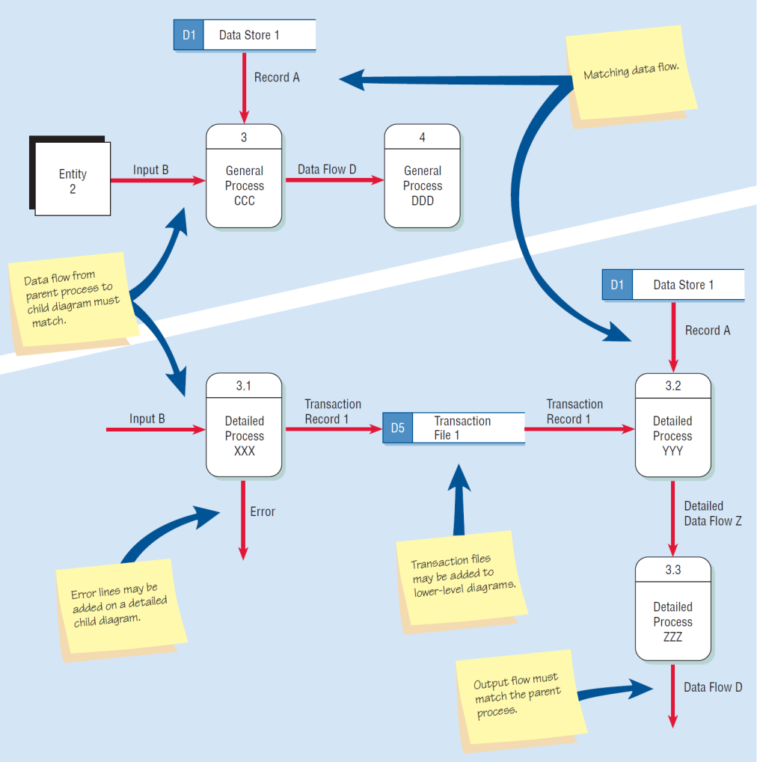
Figure 7.4 Differences between the parent diagram (above) and the child diagram (below)
Kendall & Kendall
7-<number>

Slide 19
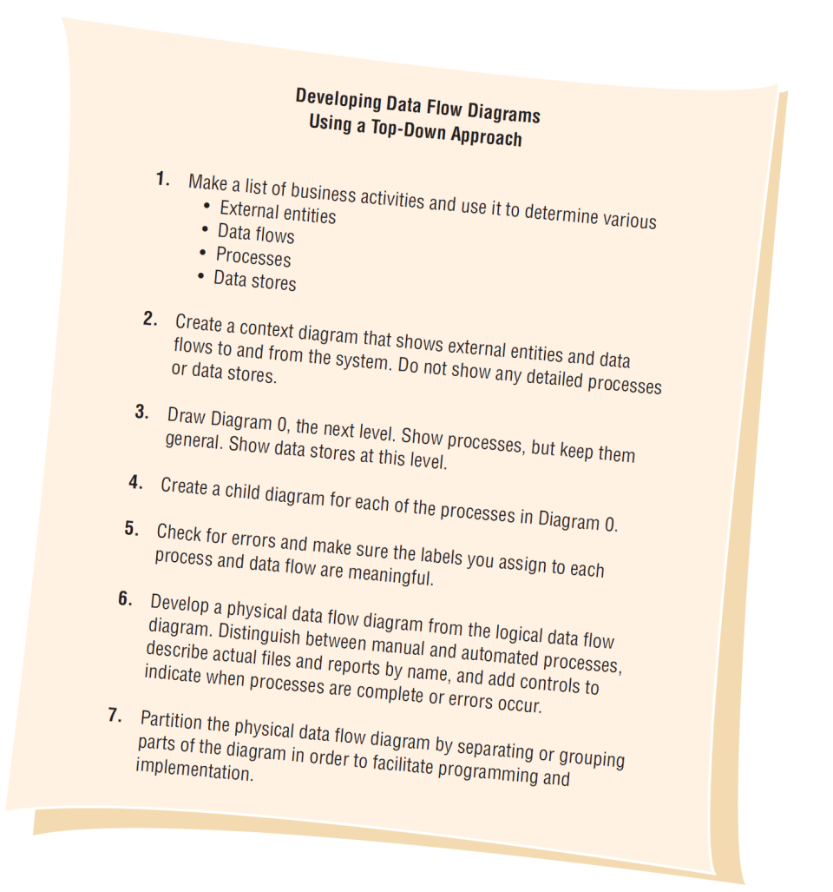
Figure 7.2 Steps in developing data flow diagrams
Kendall & Kendall
7-<number>
Notes:
Data flow diagrams can and should be drawn systematically.
To begin a data flow diagram, collapse the organization’s system narrative into a list with four categories of external entity, data flow, process, and data store. This list helps determine the boundaries of the system. Next begin drawing the context diagram.

Slide 20
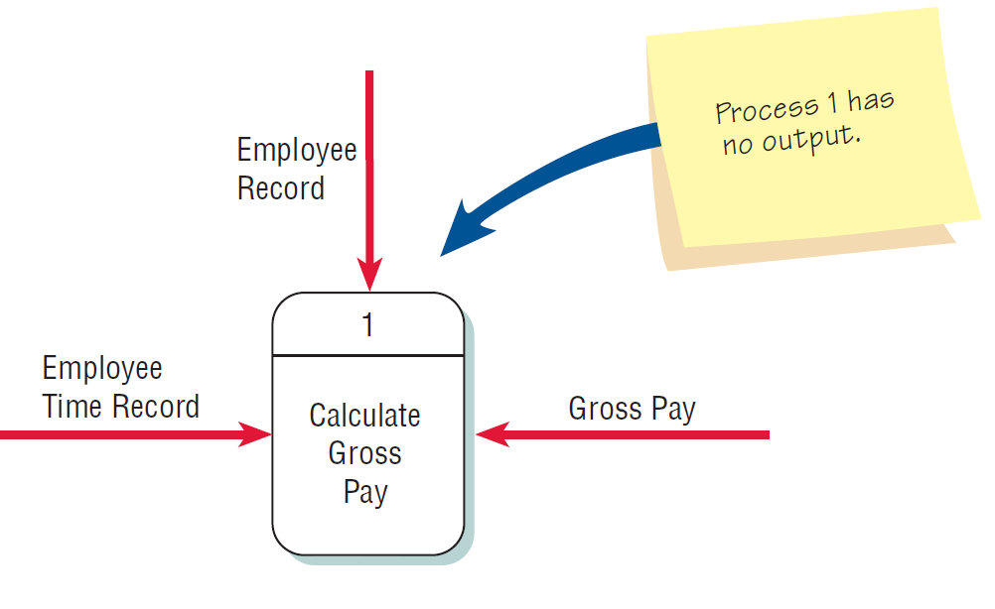
Checking the Diagrams for Errors
Forgetting to include a data flow or pointing an arrow in the wrong direction
Kendall & Kendall
7-<number>

Slide 21
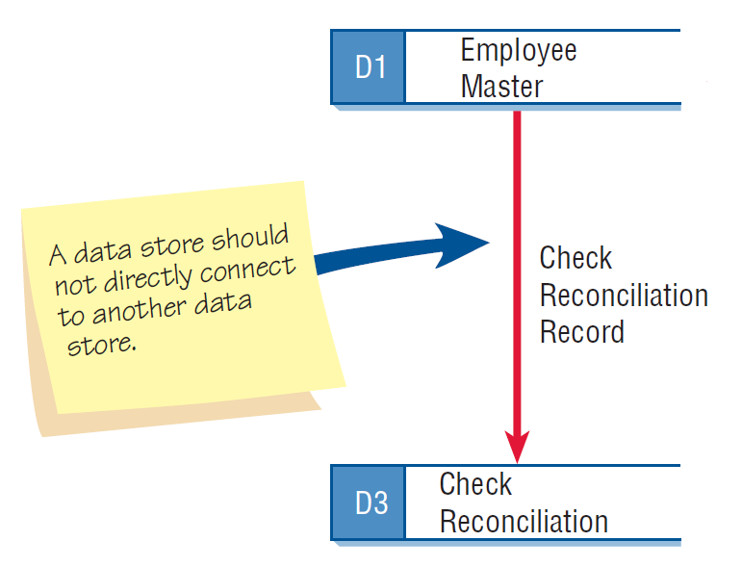
Checking the Diagrams for Errors (Continued)
Connecting data stores and external entities directly to each other
Kendall & Kendall
7-<number>

Slide 22
Checking the Diagrams for Errors (Continued)
Incorrectly labeling processes or data flow
Including more than nine processes on a data flow diagram
Kendall & Kendall
7-<number>
Notes:
Incorrectly labeling processes or data flow:
Each object or data flow is properly labeled
Data flow described with a verb.
Processes should indicate the system name or use the verb-adjective-noun format.
Having too many processes creates a cluttered diagram that is confusing to read and hinders rather than enhances communication.

Slide 23
Checking the Diagrams for Errors (Continued)
Omitting data flow
Creating unbalanced decomposition (or explosion) in child diagrams
Kendall & Kendall
7-<number>
Notes:
Each child diagram should have the same input and output data flow as the parent process.

Slide 24
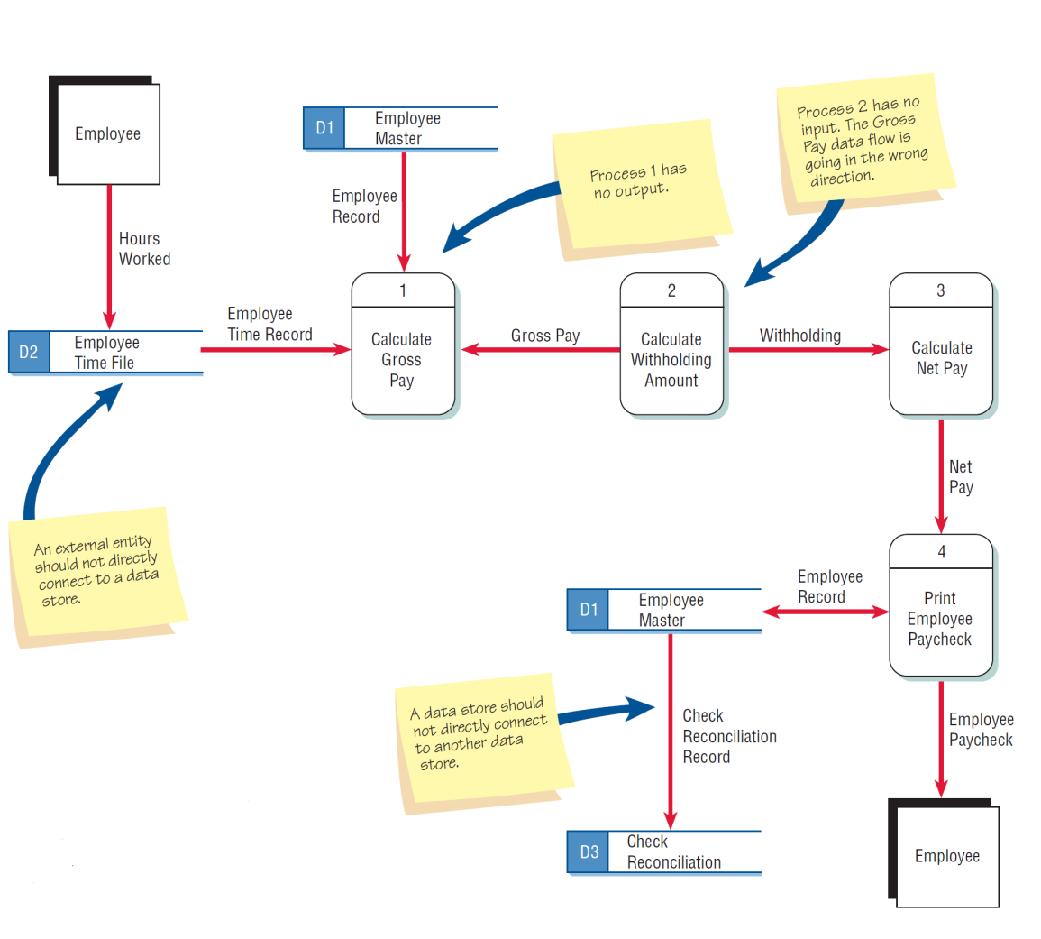
Figure 7.5 Typical errors that can occur in a data flow diagram (payroll example)
Kendall & Kendall
7-<number>

Slide 25
Logical and Physical Data Flow Diagrams
Logical
  Focuses on the business and how the business operates
  Not concerned with how the system will be constructed
  Describes the business events that take place and the data required and produced by each event
Physical
  Shows how the system will be implemented
  Depicts the system
Kendall & Kendall
7-<number>

Slide 26
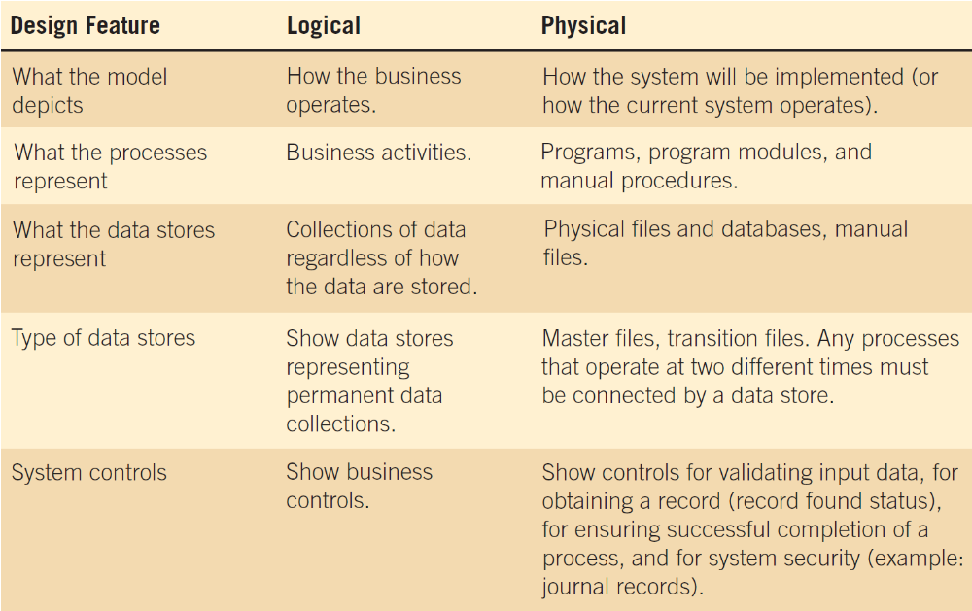
Figure 7.7 Features common of logical and physical data flow diagrams
Kendall & Kendall
7-<number>

Slide 27
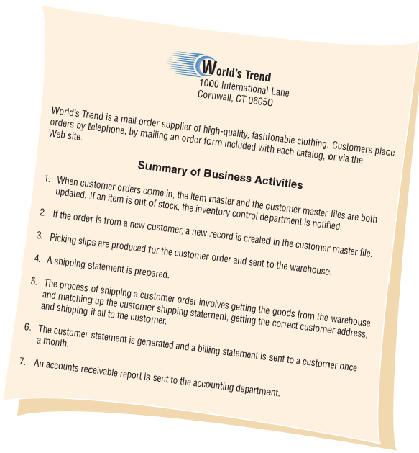
World’s Trend Online Shop
Kendall & Kendall
7-<number>

Slide 28
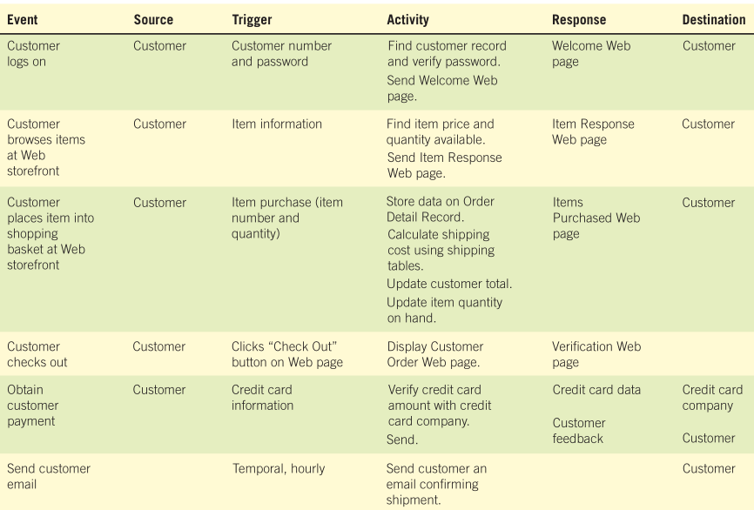

DFD & Event-Response Table
Kendall & Kendall
7-<number>

Slide 29
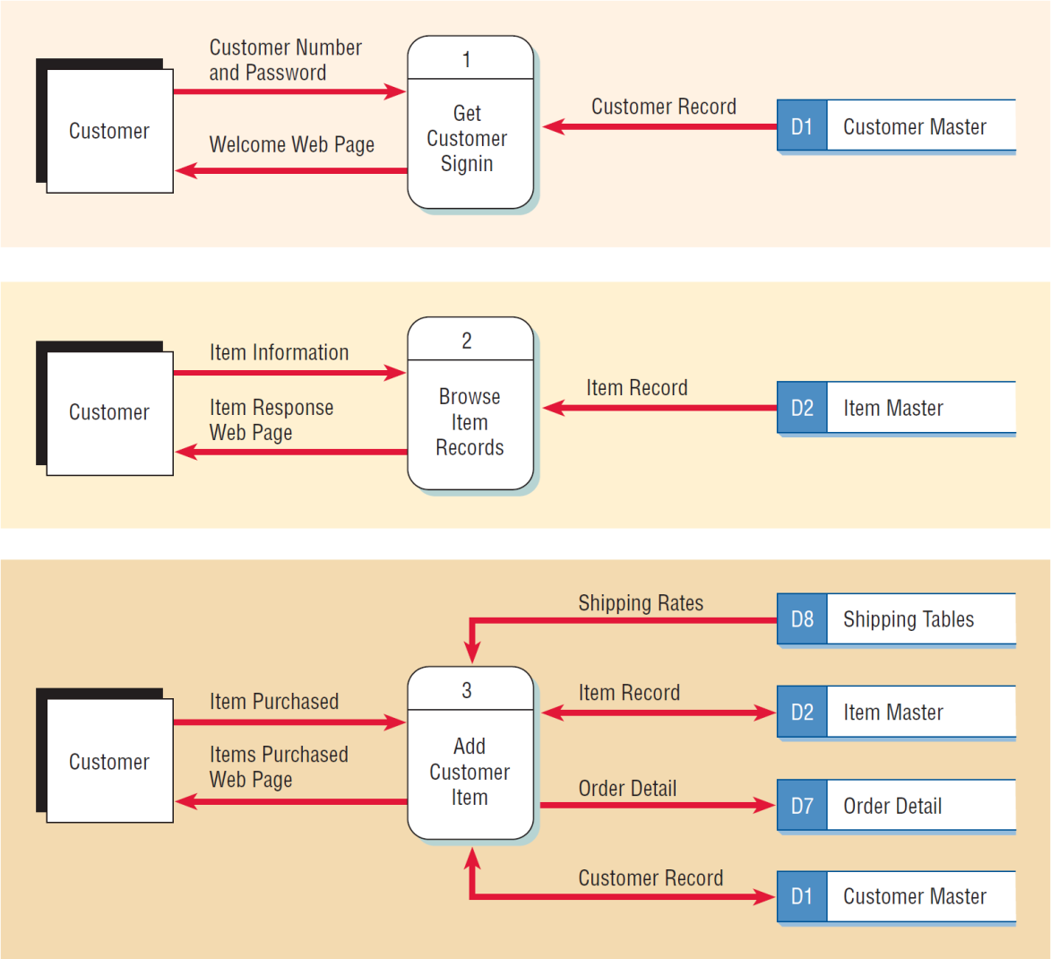
Figure 7.13 Data flow diagrams for the first three rows of the Internet storefront event response table
Kendall & Kendall
7-<number>
Notes:
A dataflow diagram fragment is represented by one row in the table.
Each DFD fragment is a single process on a data flow diagram.
All the fragments are then combined to form Diagram 0.
The trigger and response column becomes the input and output data flows.
The activity becomes the process.
The data stores are determined by examining the input and output data flows.
The advantage of building data flow diagrams based on events is that the users are familiar with the events that take place in their business area and know how the events drive other activities.

Slide 30
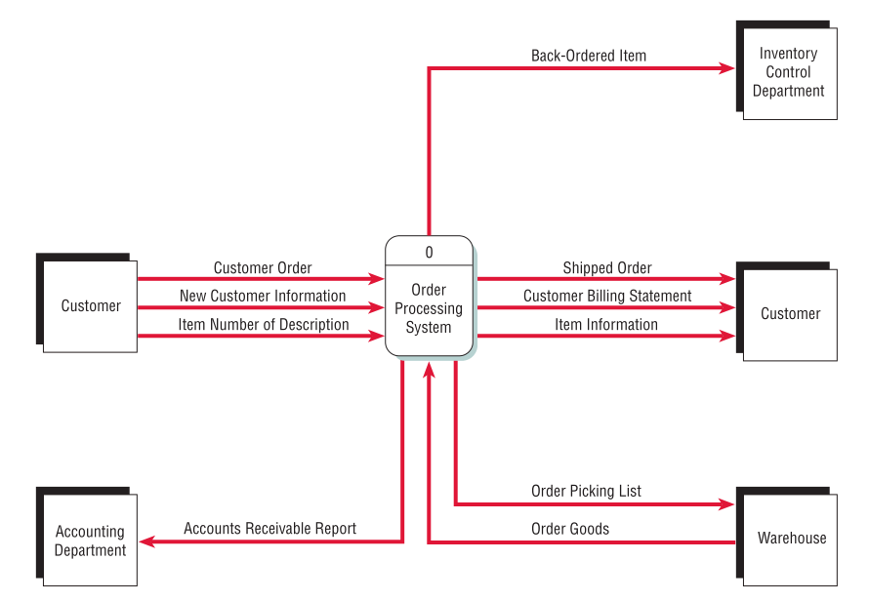
Context Diagram
Kendall & Kendall
7-<number>

Slide 31
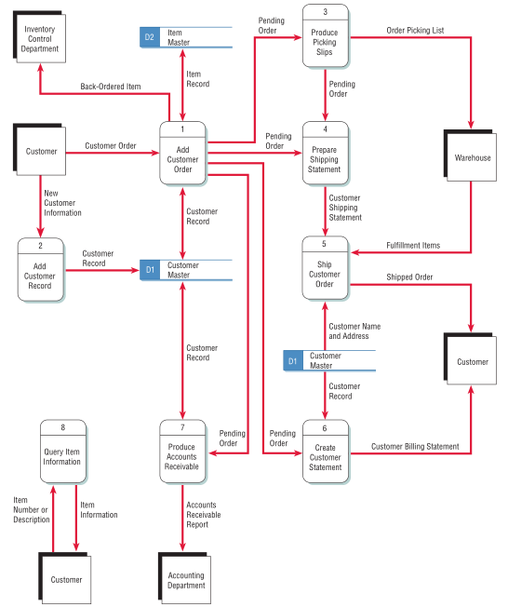
Diagram 0
Kendall & Kendall
7-<number>

Slide 32
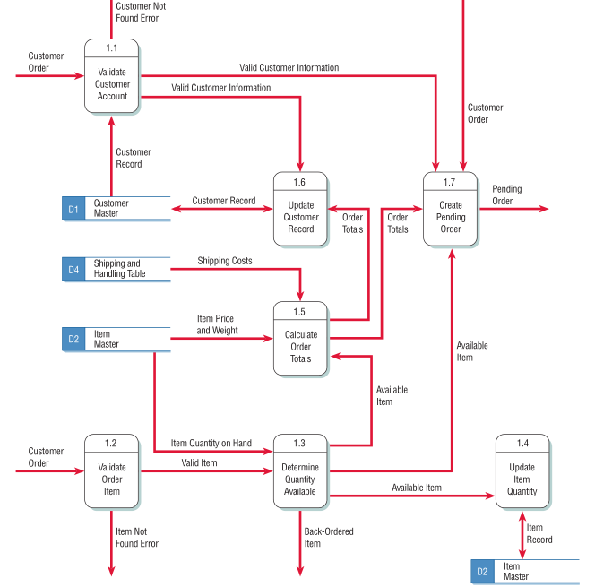
Diagram 1
Kendall & Kendall
7-<number>

Slide 33
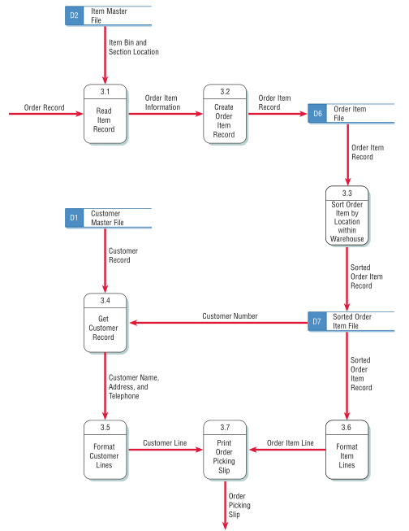
Physical DFD of Child Process 3
Kendall & Kendall
7-<number>

Slide 34
Partitioning Data Flow Diagrams
Partitioning is the process of examining a data flow diagram and determining how it should be divided into collections of manual procedures and computer programs
A dashed line is drawn around a process or group of processes that should be placed in a single computer program
Kendall & Kendall
7-<number>
Notes:
Analyze each process to determine whether it should be a manual or automated procedure.
Group automated procedures into a series of computer programs.

Slide 35
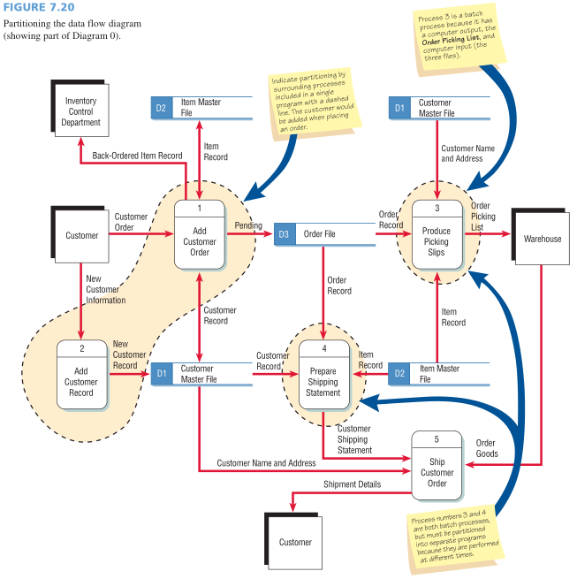
Kendall & Kendall
7-<number>

Slide 36
Reasons for Partitioning
Different user groups
Timing
Processes may be separated into different programs for security
Similar tasks
Efficiency
Consistency
Security
Kendall & Kendall
7-<number>
Notes:
Different user groups – Are the processes performed by several different user groups, often at different physical locations in the company? If so, they should be partitioned into different computer programs.
Timing - Processes that execute at different times must be in separate programs
Similar tasks - may be included in the same program
Efficiency - Several batch processes may be included in the same program for efficiency
Consistency - Several processes may be included in the same program or job stream for consistency of data.
Security – may be partitioned into different programs for security reasons.

Slide 37
Partitioning Web Sites
Improves the way humans use the site
Improves speed of processing
Ease of maintaining the site
Keep the transaction secure
Kendall & Kendall
7-<number>
Notes:
Each time data must be obtained from a data store or an external partner, a Web site designer might consider creating a unique Web form and DFD process to validate and process the data or may also use Ajax, sending a request to the server and obtain a small amount of data or an XML document returned to the same page.

Slide 38
Communicating Using
Data Flow Diagrams
Use unexploded data flow diagrams early when ascertaining information requirements
Meaningful labels for all data components
Kendall & Kendall
7-<number>
Notes:
Use unexploded data flow diagrams early when ascertaining information requirements – at this stage they can provide an overview of data movement through the system, lending a visual perspective unavailable in narrative data.
Meaningful labels for all data components – labels should not be generic.
Data flow diagrams can be used for documenting high and low levels of analysis and helping to substantiate the logic underlying the data flows of the organizations.

